Slide 1

Graphics Unit
Enniskillen Royal Grammar| Year 9

Slide 2
This is a BORING paragraph, trying to describe what GRAPHICS are all about.
Not very interesting is it!
This is what the internet was like in the beginning – nothing but text… and more text… and even more text…

Slide 3




Now look what a difference graphics can make…

Slide 4

Much more interesting! Graphics bring colour and interest all around us.
This lesson is all about why and how we use graphics.

Slide 5
How Graphics are Used
Graphics are seen everywhere around us. Images are used to convey all kinds of information and messages.
Here are some common forms of use:

Slide 6
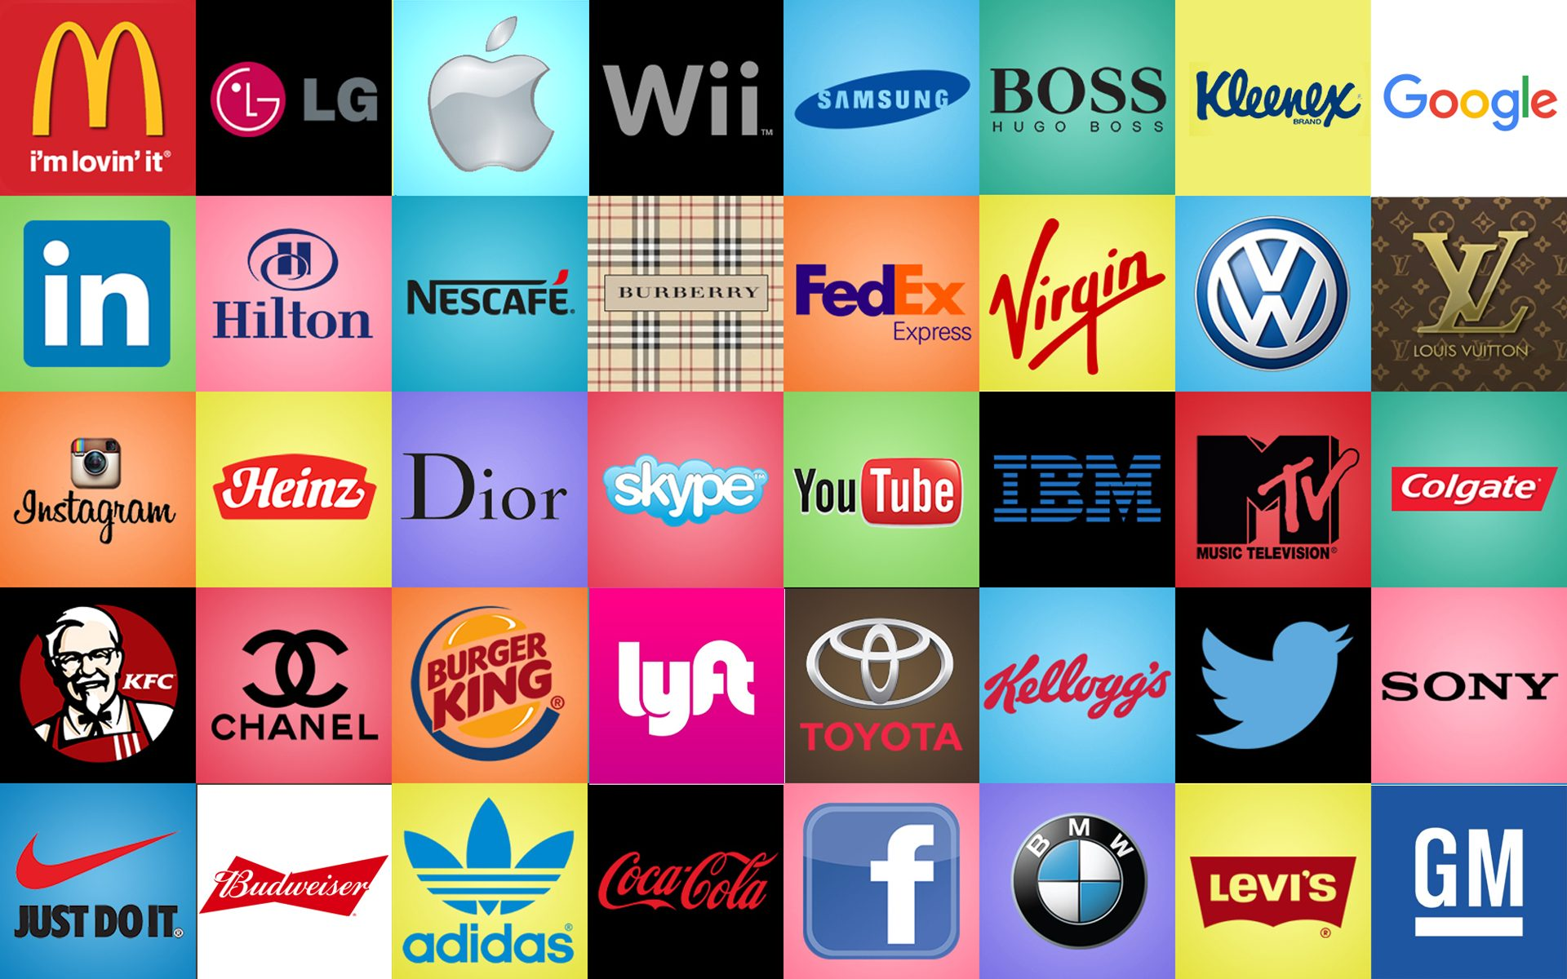
Logos
Companies are keen to make sure you recognise their product from a distance, and so a simple image is used that lets you know immediately who they are.

Slide 7
Logos
They are so valuable to a company. They are protected by law to prevent anyone else from using them. This protection is called a ‘trademark’

Slide 8

Road Signs
Signs provide information using graphics, often without words. They are excellent in places such as airports, city streets, roads and so on.

Slide 9
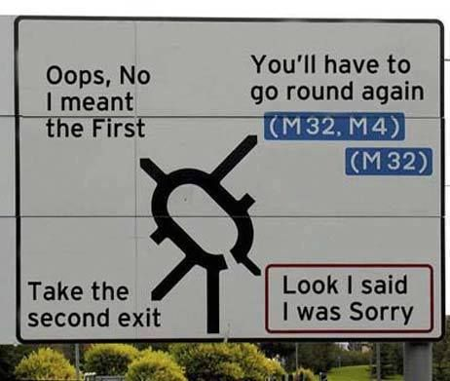
Road Signs
Signs need to be instantly recognisable and be able to overcome any language barriers.

Slide 10
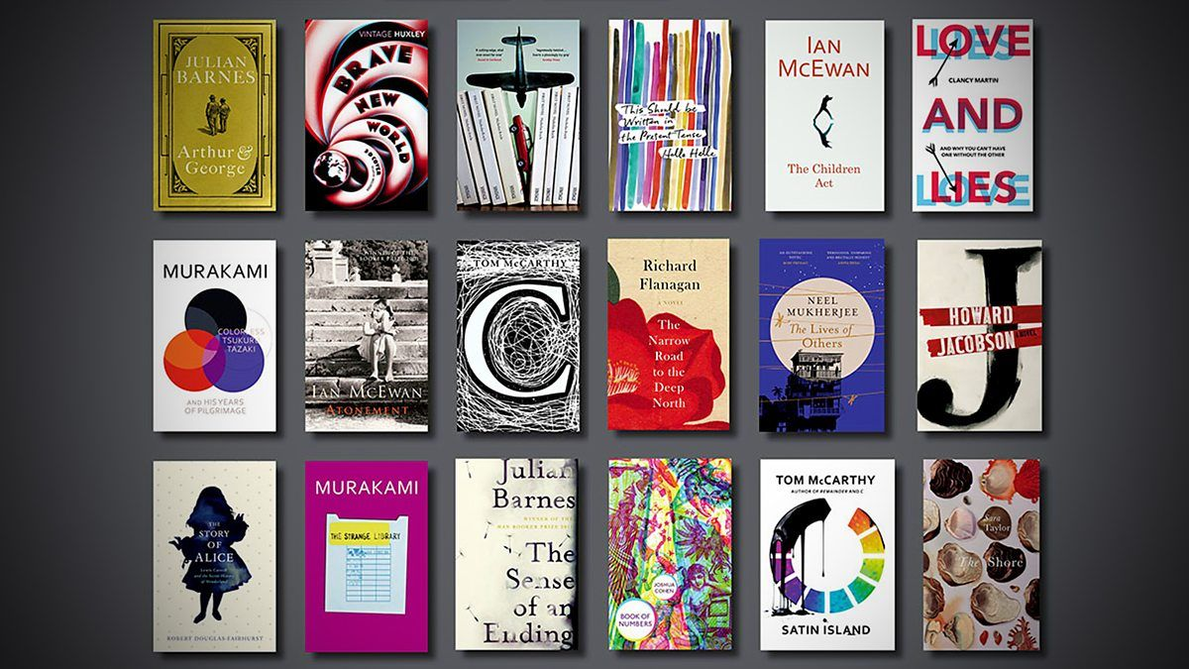
Book Covers
A book must attract your attention from a distance and so book covers use graphics to make them interesting and appealing.
“You cannot judge a book by its cover”

Slide 11
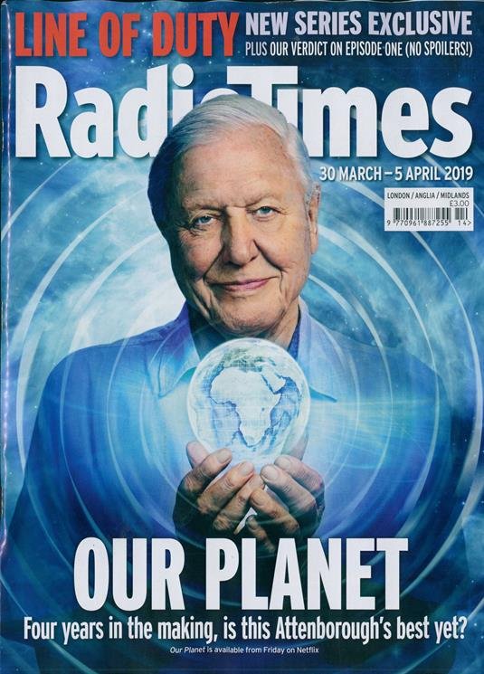
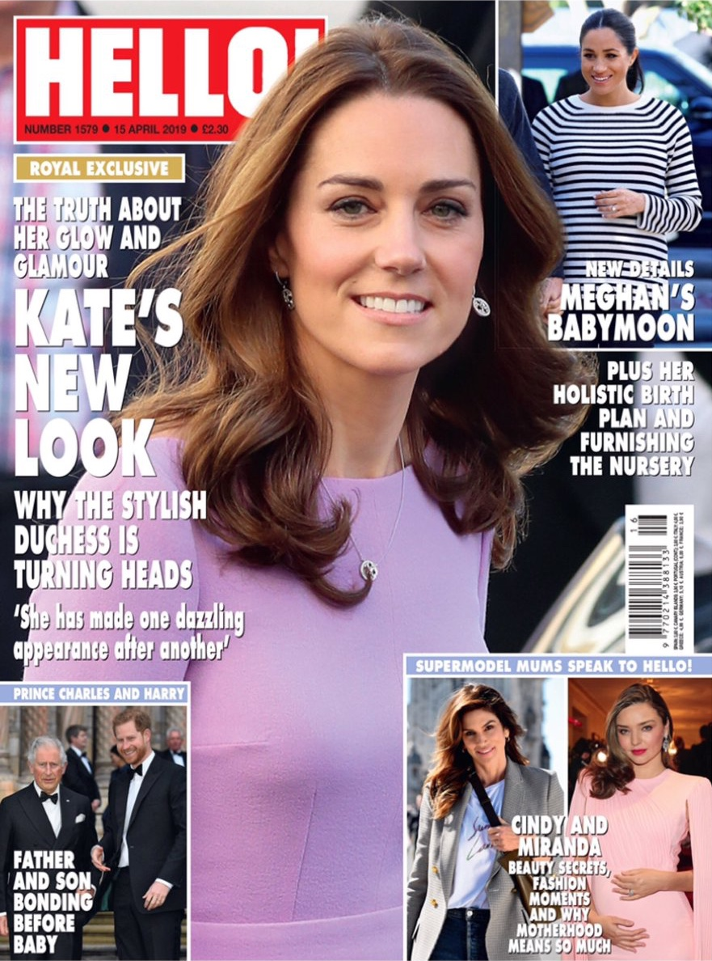

Magazines
There are so many magazines on the market that the companies have their work cut out to persuade you to buy their product. They make good use of graphics to make their covers eye-catching and vibrant. Strong images are missed with text.

Slide 12
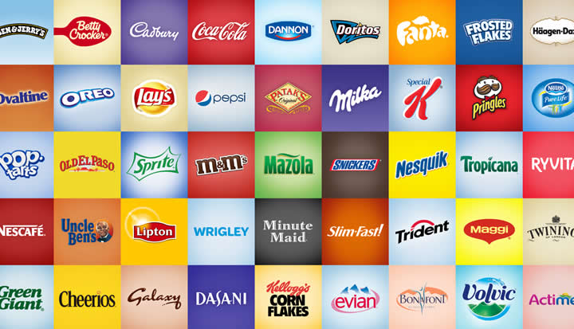
Product Packaging
The way a product is presented can have a great effect on what you think of it.
Manufacturers spend millions of pounds developing the packaging to make it attractive to you. Most packaging has some form of graphic on it. Next time you buy something have a look.

Slide 13


Activity
Mr Butler is looking for a new logo for his Computer Graphics Company.
He wants to have:
  3-5 colours used
  A simple image or text
  Clear, easily printed logo.
Use an A4 page to design a logo which is eye catching, clear and tells potential customers what the company can offer!
Upload a photo of this to google classroom for marking!

Slide 14
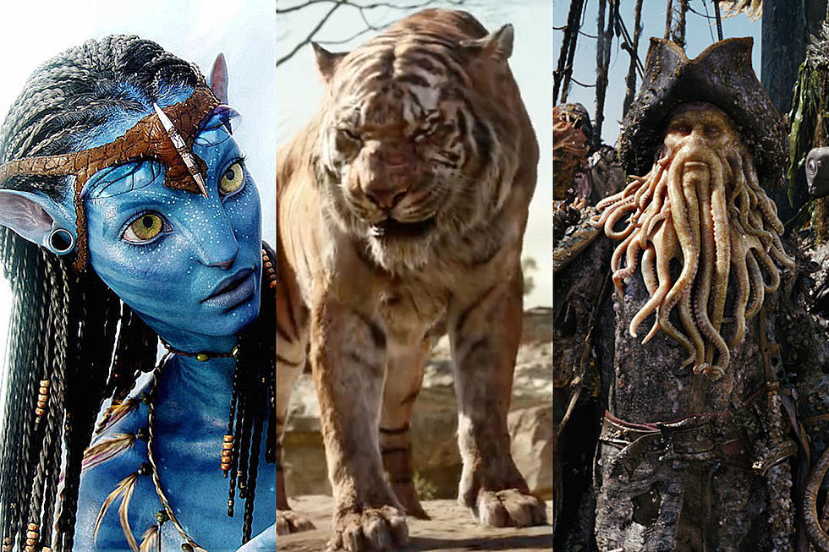
Computer Generated Imagery (CGI)
Computer generated imagery means that computer graphics are used to create special effects in movies and computer/ video games.
Specialist computer software is used to make the CGI for movies but it requires a huge amount of skill in order to create something which looks realistic.

Slide 15
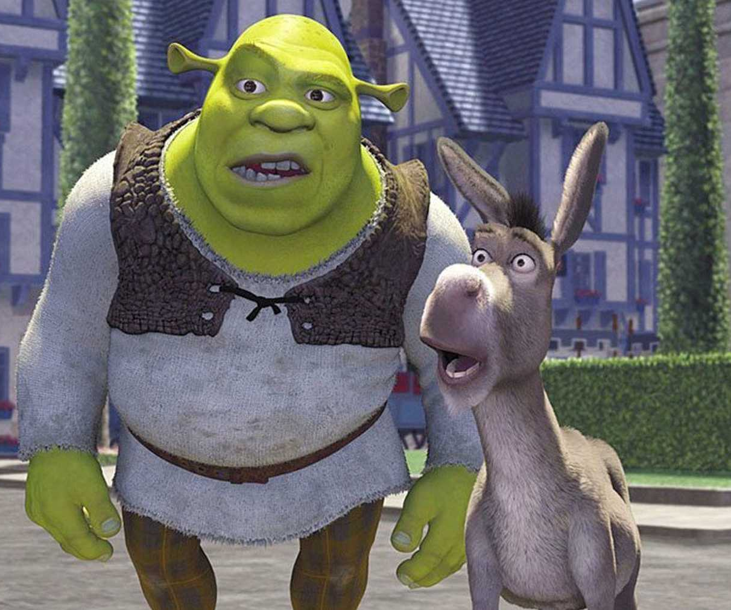
Computer Generated Imagery (CGI)
More powerful computers have allowed CGI to be used in many of the movies made today for example, Lord of the Rings, Pirates of the Carribean and Avengers where the CGI is mixed with human actors.
Whole movies can also be made with just CGI, such as Shrek, Ice Age and Polar Express.
CGI is now so good it can be hard to tell which is real and what is made by the computer.

Slide 16
Turn off your monitor.
You will need to work with the person next to you for the next two minutes.
You will only need a scrap piece of paper and a pen
The Question:
List all of the different SOURCES of graphics you can.

Slide 17

Sources of Graphics
Graphics can be obtained from various places. The main ones are:
Clipart
Internet (Google Images/Flikr/other photo sharing sites)
CDs/DVDs
Digital Camera
Hand Drawn Images (scanned in)
Magazines (scanned in) ___
NOTE: A scanner is NOT a source of graphics, it is a device for importing graphics from paper onto the computer.

Slide 18

Bitmap Images
Bitmap images are made up of a grid of tiny square dots called pixels.
Each pixel can be its own colour – but only one colour at any one time!
When you zoom into a bitmap image, it is possible to see these individual pixels, or you see these ‘jagged’ edges. This is called pixilation.
Bitmaps store information on each individual pixel, meaning it is perfect for highly detailed photographs – however, can result in large file sizes.

Slide 19

Vector Images
Some graphics do not use a grid of pixels, but instead are ‘calculated’ using mathematical equations to create lines, curves and shapes.
It’s easily scalable/resizable as it doesn’t rely on fixed point references or grids to create its shapes.
Although, think of how many individual shapes would be required for a photo – too many individual shapes so Vector graphics should only be used for simple images such as logos.

Slide 20

Design your own MINECRAFT, EMOJI or MARIO pixel image in MS Excel or MS Word using the table facility (10 x 10) to design a 2-bit colour image. You can create your own colour code.
Below your grid, show how the image can be encoded as a grid of numbers.
Use a Key to label your colour system:
00 = White 01 = Black
10 = 11 =
00 | 00 | 00 | 00 | 00 | 00 | 00 | 00 | 00 | 00
00 | 00 | 00 | 00 | 00 | 00 | 00 | 00 | 00 | 00
00 | 00 | 00 | 00 | 00 | 00 | 00 | 00 | 00 | 00
00 | 00 | 00 | 00 | 00 | 00 | 00 | 00 | 00 | 00
00 | 00 | 00 | 00 | 00 | 00 | 00 | 00 | 00 | 00
00 | 00 | 00 | 00 | 00 | 00 | 00 | 00 | 00 | 00
00 | 00 | 00 | 00 | 00 | 00 | 00 | 00 | 00 | 00
00 | 00 | 00 | 00 | 00 | 00 | 00 | 00 | 00 | 00
00 | 00 | 00 | 00 | 00 | 00 | 00 | 00 | 00 | 00
00 | 00 | 00 | 00 | 00 | 00 | 00 | 00 | 00 | 00

Slide 21
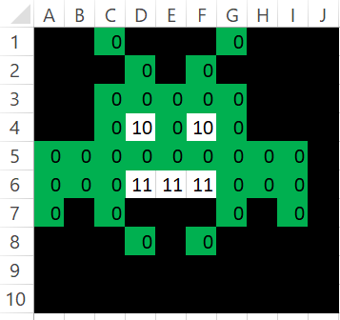
Now you have designed your Emoji,
Remove the background colouring of your image.
Place your ‘code’ in a single line
Send this ‘code’ to your partner (the person next to you)
At the end of the email, also give them the ‘key’.
Once you receive this ‘file’, recreate your partners image on your screen using only the code sent (Don’t just copy what is on their screen!)

Slide 22

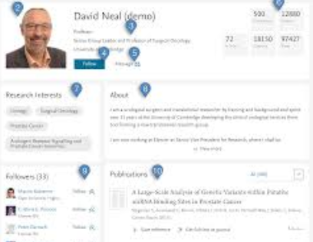
Bitmap and Vectors – What do you already know?
TASK: In pairs, create two fact files; one of which will be for a bmp file and one for a SVG file.
Once complete, print two copies of each fact file. Each person in the pair should keep a copy. Alternatively Email this to one another!

Slide 23
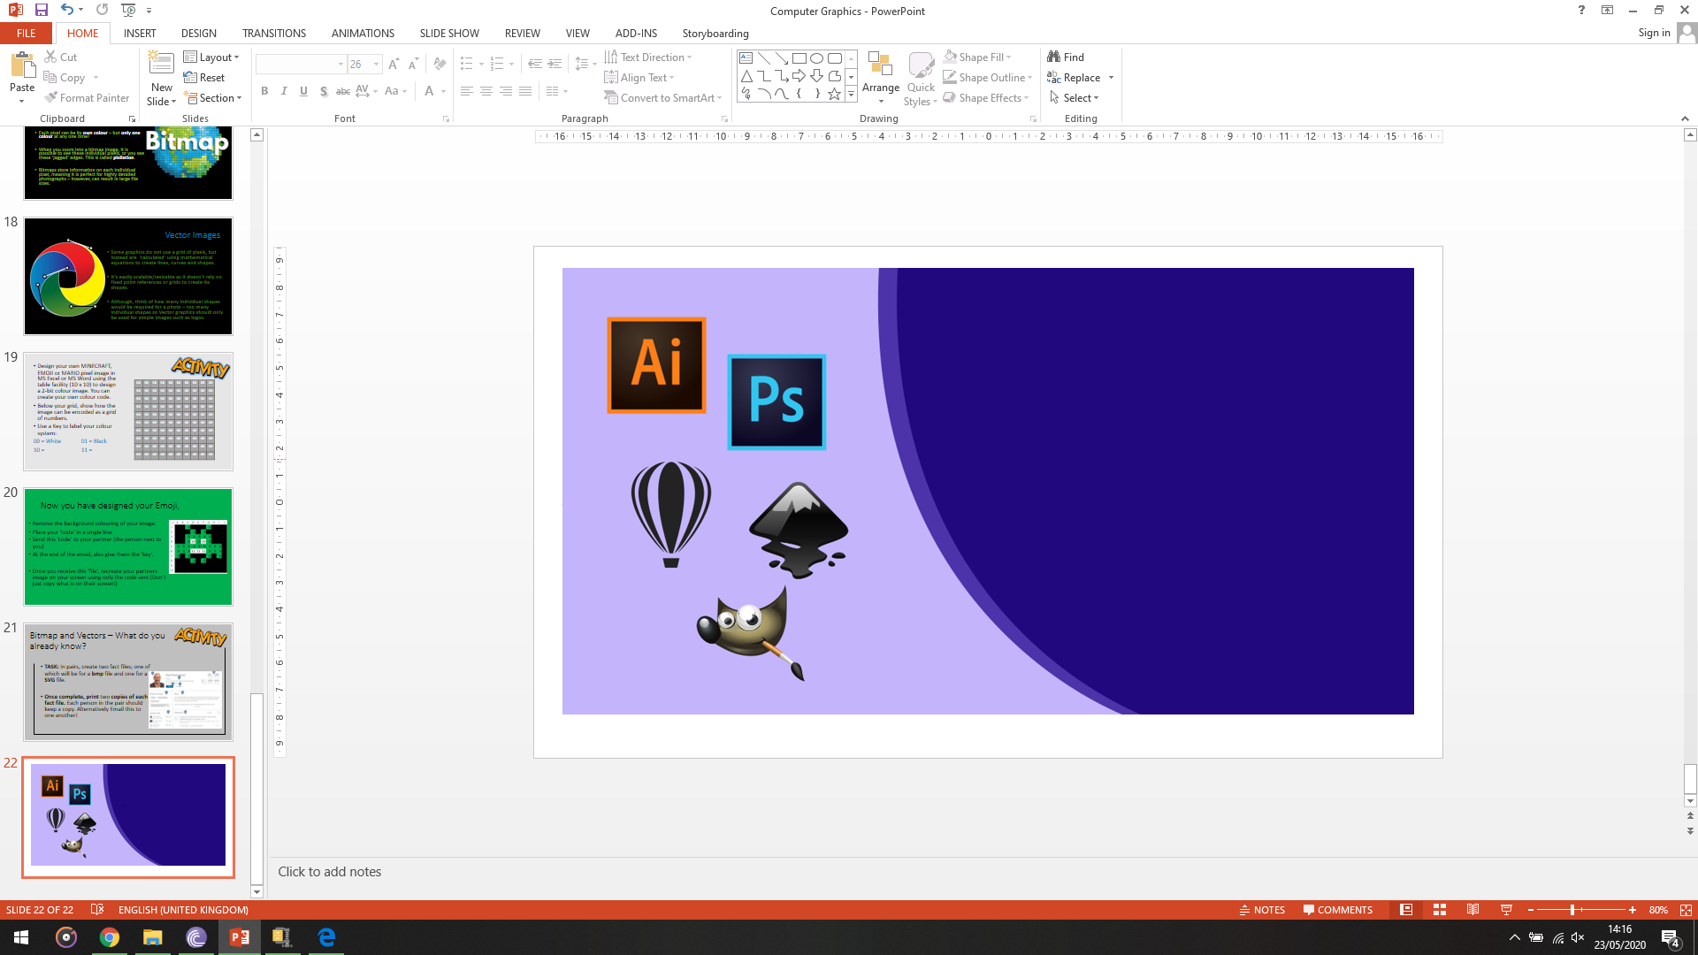
Computer Graphic Programs
One of the most famous graphics packages is Adobe Photoshop, although there are numerous others which you can use, designed for a whole range of users. Examples include:
MS Paint Adobe Illustrator
CorelDRAW GIMP PIXLR
Paintshop Pro Picasa

Slide 24
Computer Graphic Programs
With these packages, there are several features that are common throughout. As PhotoShop is the most commonly used package, we will use it. However, GIMP and PIXLR are also highly recommended as they are free to use!
MS Paint Adobe Illustrator
CorelDRAW GIMP PIXLR
Paintshop Pro Picasa

Slide 25
Computer Graphic Programs
Although, some professional Comic Book Artists prefer to use Adobe Illustrator as it is an example of a Vector Based graphics package – so images can be scaled much easier. It’s perfect for Logo Designers
MS Paint Adobe Illustrator
CorelDRAW GIMP PIXLR
Paintshop Pro Picasa

Slide 26

We will use Photoshop
As we may wish to edit real photographs, which we have already said use Raster (bitmap) formats, we are going to use Adobe Photoshop for our Image Editing.
We have this available in school, and can easily be imported and reopened in GIMP or PIXLR if you wanted to continue working at home.

Slide 27
So Let’s have a look at some of these features…

Slide 28
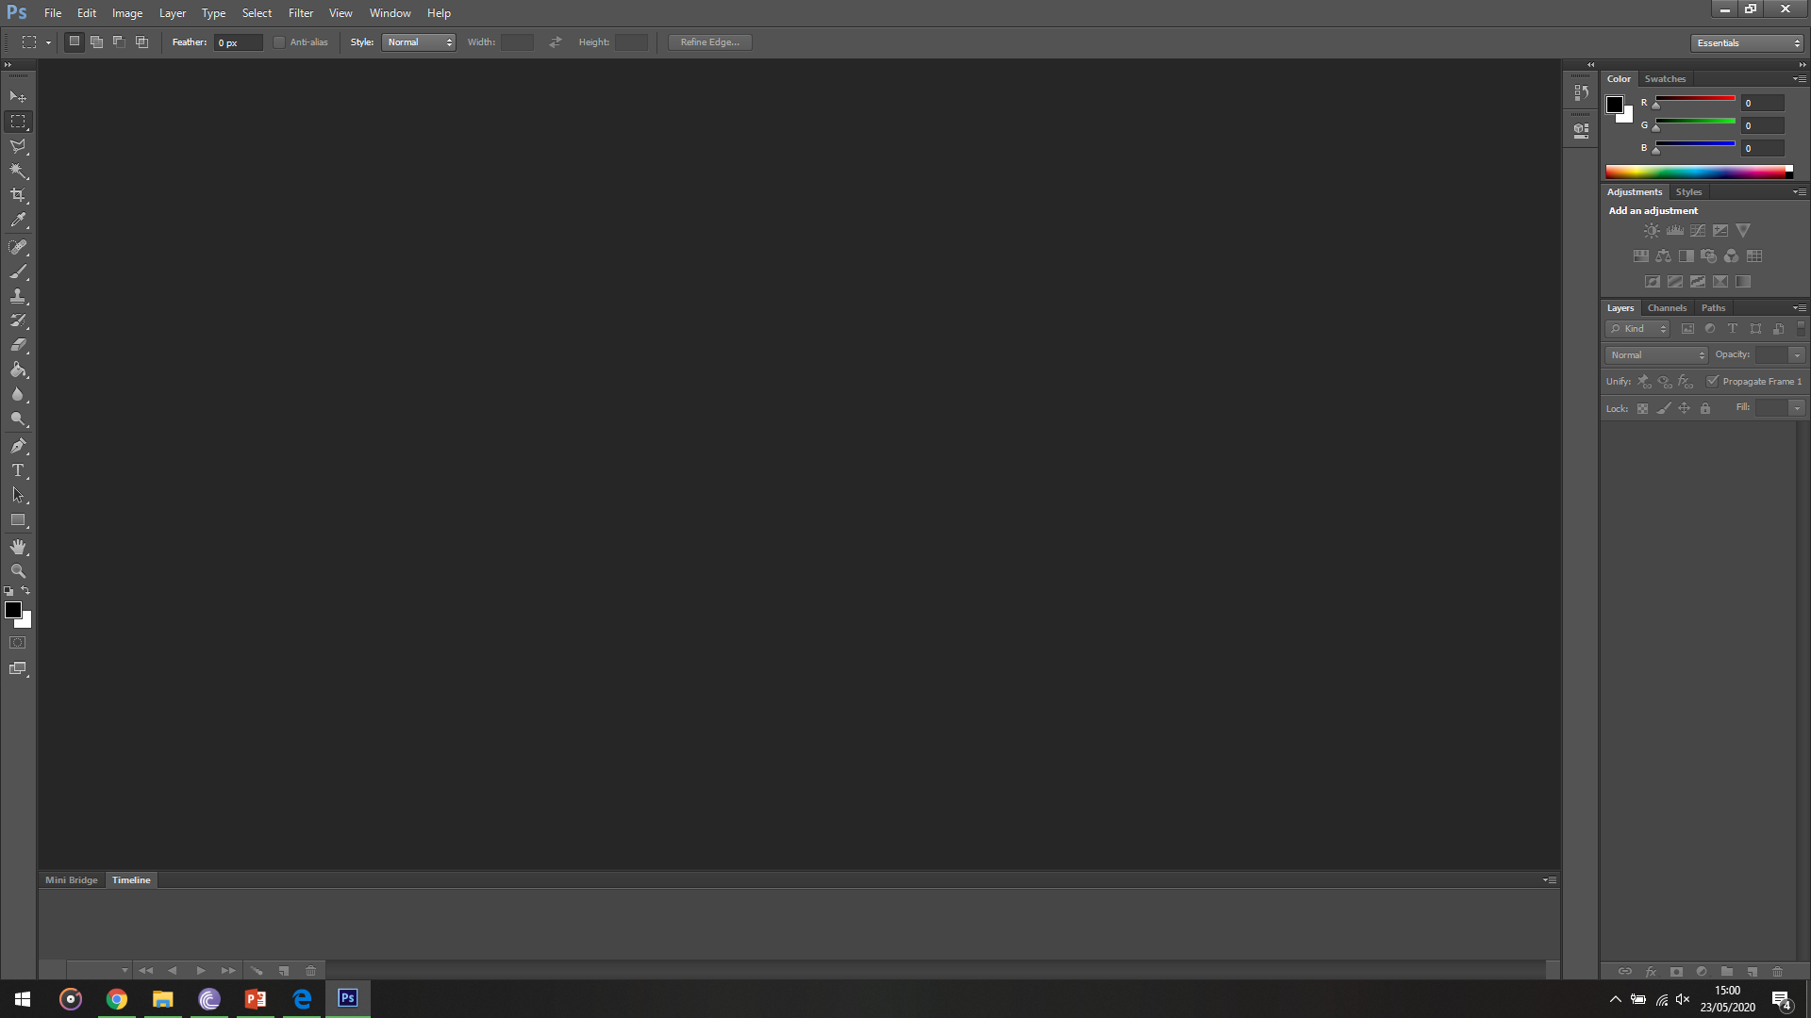
The Color and Swatches panels usually sit here. You can click between them using the tabs
This is the Toolbar. Not only does it allow for different options using the tabs, but also gives you specific options based on the tool you have selected from the Toolbox.
The most common Tools can be found here, in your Toolbox. If you don’t see this, You can go to Window > Tools
This is the Layers panel. You can select and edit different layers here.
This is Adobe PhotoShop CS6, although the general layout does not change drastically between versions

Slide 29
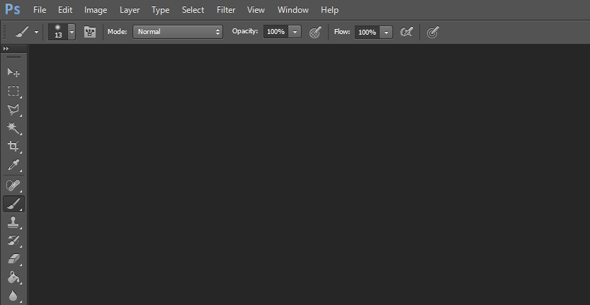
For example, if you change to a different Tool, you can see the options at the top change for that specific tool
Remember, PhotoShop is a Professional package. This means that there are literally THOUSANDS of different tweaks you can make to an image. Don’t expect to be a professional after just a few lessons. Over the next few lessons, you will be introduced to just some of the amazing things PhotoShop can do!

Slide 30
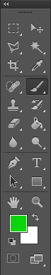
Let’s have a look at the tool box first of all
This is the Marquee tool. It allows you to select part of an image. Holding Down the left mouse button lets you Change the shape of the marquee

Slide 31
Let’s have a look at the tool box first of all
The Move tool lets you move the selection or whole layer around the screen.

Slide 32
Let’s have a look at the tool box first of all
The Lasso tool is similar to the Marquee tool, however this allows you to select around a specific shape in an image. The Magnetic Lasso can be found by holding down the left click. This is used to ‘stick’ to a contrasting shape.

Slide 33
Let’s have a look at the tool box first of all
This is the Magic Wand tool. Clicking on an area it will select pixels with the same or very similar colour. You can change the tolerance in the toolbar to allow a bigger or smaller range in the tool’s selection tone.

Slide 34
Let’s have a look at the tool box first of all
The Crop tool does the same as it does in Microsoft Word and other packages. It allows you to select an area of an image and discard everything outside this area.

Slide 35
Let’s have a look at the tool box first of all
This is the eye dropper tool. It can get the colour from any part of the image.

Slide 36
Let’s have a look at the tool box first of all
This less-used tool is the Spot Healing tool, as well as the Patch and even the Red Eye tool. These are designed to resolve blemishes and where photos capture red eyes if the flash is on.

Slide 37
Let’s have a look at the tool box first of all
One of the most used tools is the Brush tool. It allows you to draw over your graphic using a variety of brush types. You can change the brush type, as well as size, from the toolbar.

Slide 38
Let’s have a look at the tool box first of all
This is the Clone Stamp tool. This tool is special as it allows you to hold Left Mouse + Alt on the keyboard to select an area on the screen.
When you release the click and click elsewhere, you can copy an area, in essence, ‘clone’ where the previous click was.

Slide 39
Let’s have a look at the tool box first of all
This History Brush tool can be used to ‘undo’ what has been done to a selected area of the screen.
Use this tool to restore a portion of an image to an earlier state, while leaving the rest of the modified image alone

Slide 40
Let’s have a look at the tool box first of all
The Eraser tool does exactly as it suggests – it rubs out part of the selected layer. It is just important you have selected the layer you wanted in the Layers panel at the bottom right of the screen!

Slide 41
Let’s have a look at the tool box first of all
The Paint Bucket Tool allows an area to be filled with a solid colour. You can also find the Gradient tool here – allowing you to fill the selected area with a gradient instead!

Slide 42
Let’s have a look at the tool box first of all
The Blur, Sharpen, and Smudge tools can be found here. They allow you to clarify the edges or even fade in edges of objects here.

Slide 43
Let’s have a look at the tool box first of all
There are three tools here: the Dodge, Burn and Sponge tools can be found here. These let you lighten or darken areas – mainly used to make a 2D shape look more 3D by adding shadowing/shine effects.

Slide 44
Let’s have a look at the tool box first of all
These next tools could realistically be placed together. The Pen and Text tools allow you to add freehand or font text onto the screen. It creates a separate layer on top of the currently selected layer.

Slide 45
Let’s have a look at the tool box first of all
These tools are less commonly used, and allow for features such as editing the Zoom of the preview image or draw a basic rectangles/shapes on the screen.

Slide 46
Let’s have a look at the tool box first of all
So this is the Colour selection. You can click on the Green and White squares to change the colours of the brush, or click the double arrow to switch these colours around. The icon in the bottom left allows you to reset the selected colours back to Black and White.

Slide 47

Well, now we know the theory…
LET’S GET SOME PRACTICAL!

Slide 48
Adobe Photoshop
STEP:
1
Tool/Skill Used:
Organisation
Purpose:
Ensure we can find all of our files and folders for future.
Create a new folder called ‘Simpsons Photoshop’ inside of your Year 9 > ICT Folder.
Save the file HOMER.png into this folder.

Slide 49
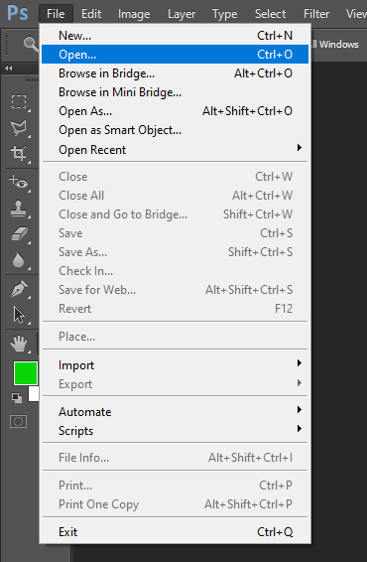
Adobe Photoshop
STEP:
2
Tool/Skill Used:
Organisation
Purpose:
Opening/Importing a graphic into Photoshop
Open Adobe Photoshop from My Apps.
Go to File > Open and open the HOMER.png image

Slide 50
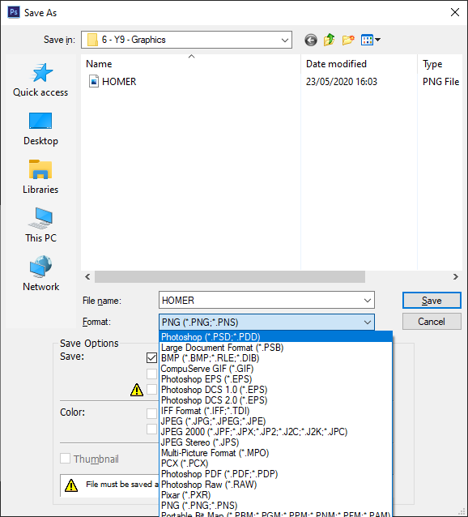
Adobe Photoshop
STEP:
3
Tool/Skill Used:
Organisation
Purpose:
Saving a Photoshop File
Now We should have a Homer Simpson on screen.
Before we do ANYTHING, go to File > Save As…
We need to save this image as a .psd file

Slide 51



Challenge!
You have 5 minutes to ‘fix’ Homer to look like the image on the right.
So,
  No Background
  No blue eyes
  No green marks around hit mouth
YOU MUST USE AT LEAST 3 TOOLS FROM THE TOOLBOX
YOU CANNOT JUST COPY IN A ‘FIXED IMAGE’.
YOU CAN ONLY USE ONLY LAYER

Slide 52
Hands Up Discussion
Which Tool did you use to make his eyes white?
Which Tool did you use to remove the background?
Which Tool did you use to remove the green dots?
Remember there may be more than one right answer!

Slide 53
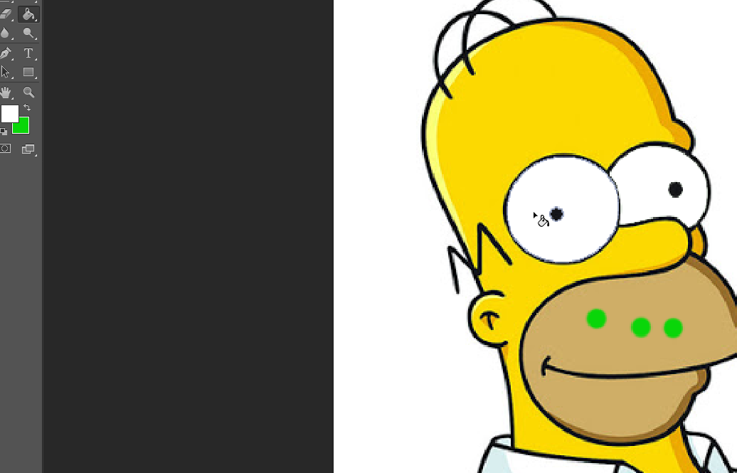
Adobe Photoshop
STEP:
4
Tool/Skill Used:
Paint Bucket
Purpose:
Make Eye Colour White
Select the Paint Bucket Tool from the Toolbox
Make sure the Colour White is selected
Click on the blue eye to fill it white.

Slide 54
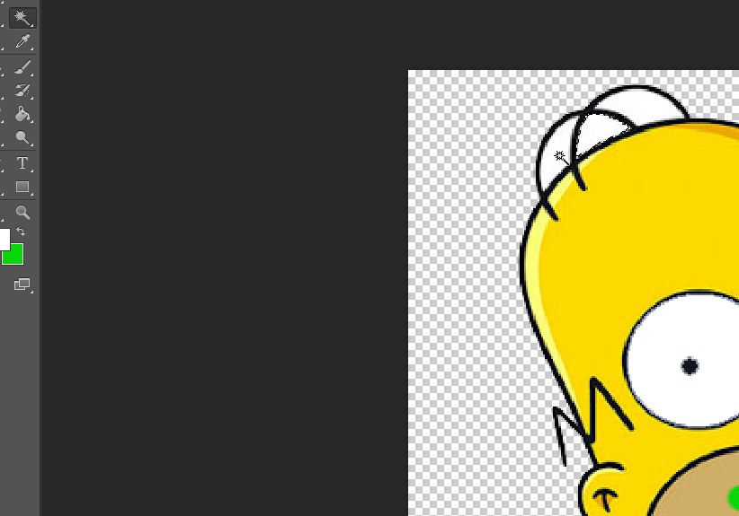
Adobe Photoshop
STEP:
5
Tool/Skill Used:
Magic Wand
Purpose:
Remove background colour
Select the Magic Wand Tool from the Toolbox
Click on the white background
Press Delete (Del) on the keyboard
Don’t forget to delete the white around his hair!

Slide 55
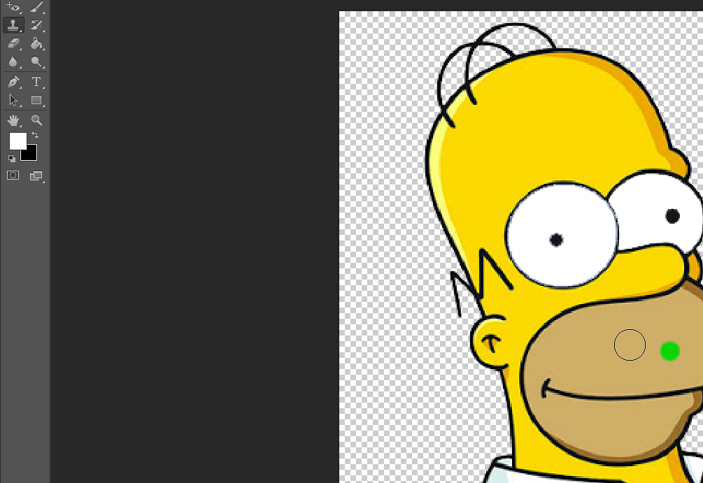
Adobe Photoshop
STEP:
6
Tool/Skill Used:
Clone Stamp Tool
Purpose:
Remove the green dots around Homer’s beard.
Select the Clone Stamp Tool
Whilst Holding ALT, click on a ‘good’ section of Homer’s beard, click.
Release ALT.
Now hover one of the green dots and click/drag to ‘clone’.

Slide 56
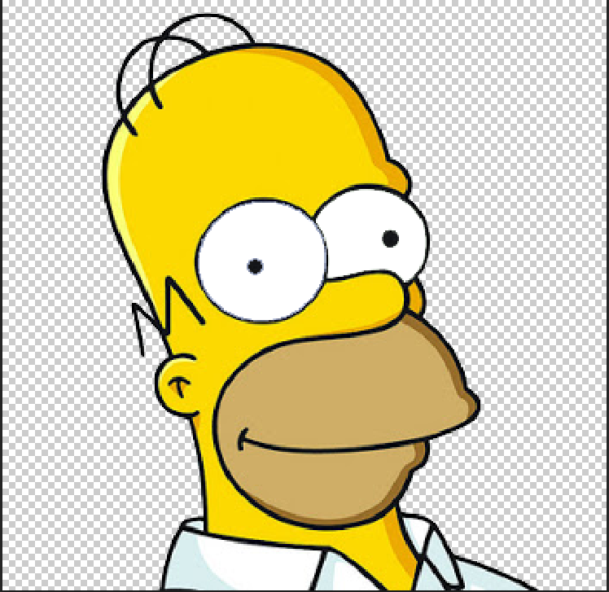
Adobe Photoshop
STEP:
7
Tool/Skill Used:
Organising
Purpose:
Save the PSD file and also as an image
Go to File > Save to save the .psd (Photoshop) file.
We also want to go to File > Save As… We need to select .png to save as an actual image!

Slide 57
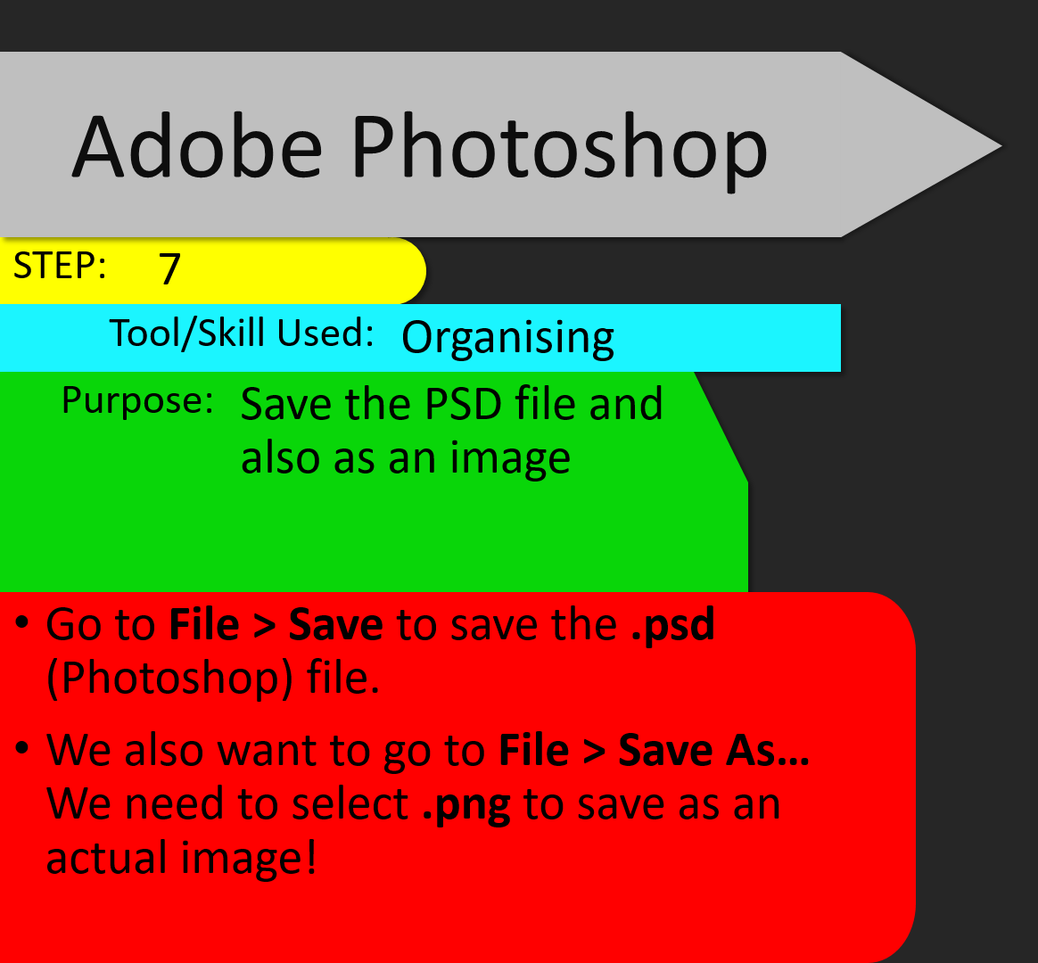


Slide 58
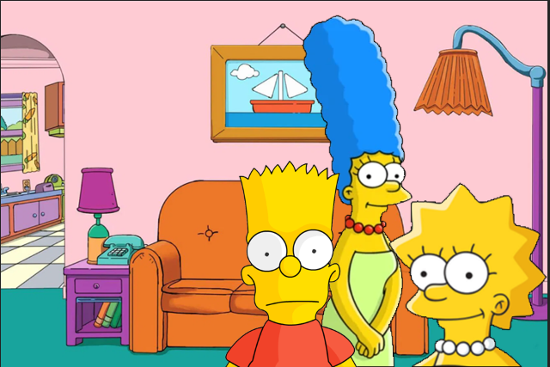
Adobe Photoshop
STEP:
8
Tool/Skill Used:
Layers
Purpose:
Experiment with Layers
Open ‘Activity 2.png’ in Adobe Photoshop.
Copy Homer.png and place him next to his family.
Use the Cursor tool to move him into position

Slide 59
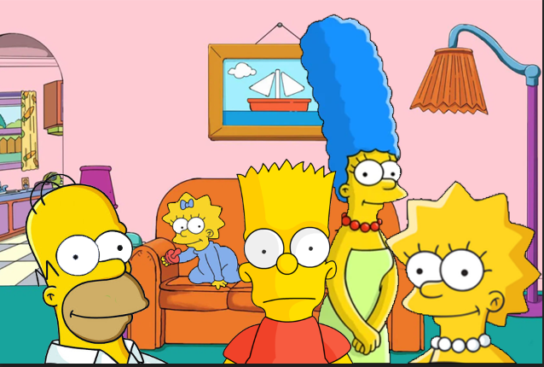
Adobe Photoshop
STEP:
9
Tool/Skill Used:
Layers
Purpose:
Experiment with Layers
We have forgotten Maggie!
Using the Skills you have learnt, find a picture of Maggie on the internet – add her into this family photo.
Place her on the sofa looking at the camera.

Slide 60
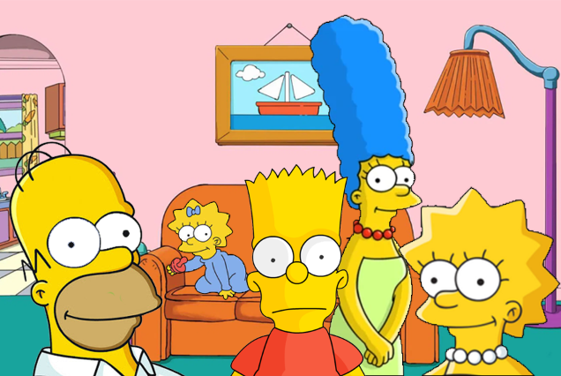
Adobe Photoshop
STEP:
10
Tool/Skill Used:
Sizing
Purpose:
Ensure layers are correctly sized in proportion to the rest of the image
So, we have probably been able to add in these. However, did you find that Homer was a little…short? Let’s fix that.
Click on the Homer Layer
Click on Edit > Transform > Free Transform. Or Press Ctrl + T. Hold Shift to maintain aspect ratio.
Resize Homer to be a little more realistic in size.

Slide 61
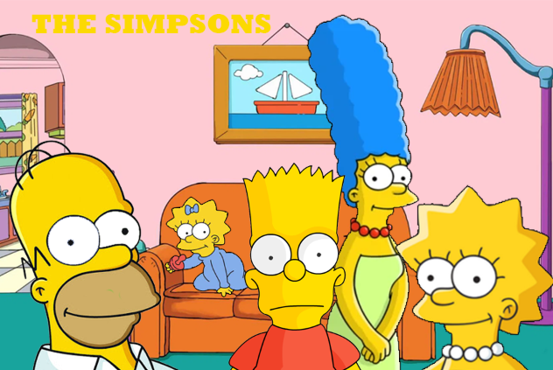
Adobe Photoshop
STEP:
11
Tool/Skill Used:
Text/Font
Purpose:
Add text to your graphic.
Use the Text tool to add ‘The Simpsons’ onto the screen.
Position this into the top left of the screen.
Make the Text YELLOW

Slide 62
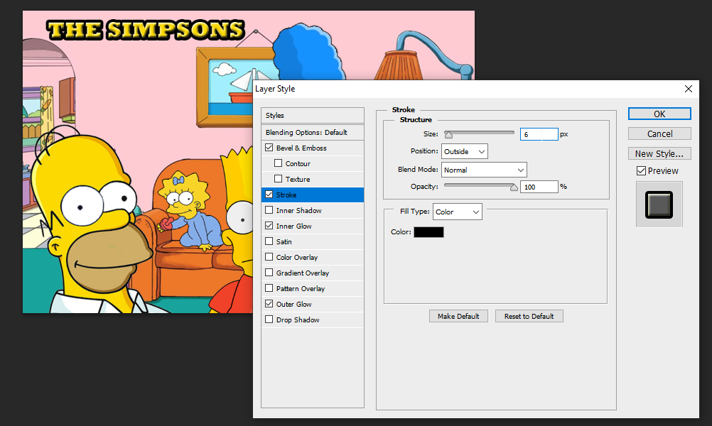
Adobe Photoshop
STEP:
12
Tool/Skill Used:
Blending Options
Purpose:
Make the text on screen really stand out. Note: This can also be used on standard layers.
In the layers panel, click on the text layer.
Right Click and select Blending Options
Add some blending options. Play around with them to see if you can make your text really stand out!

Slide 63

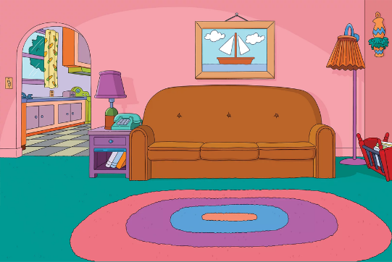
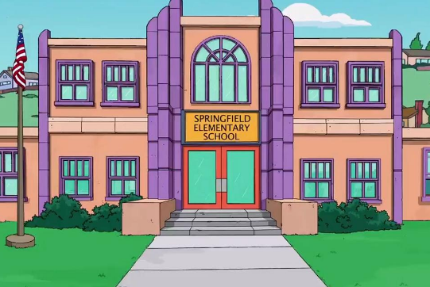
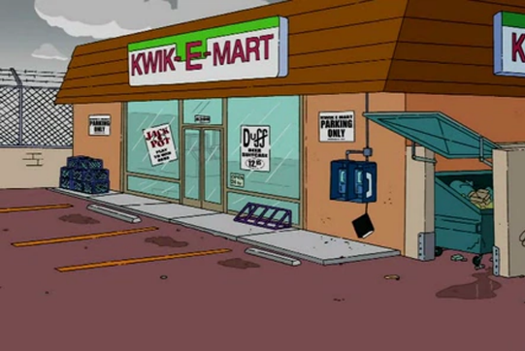
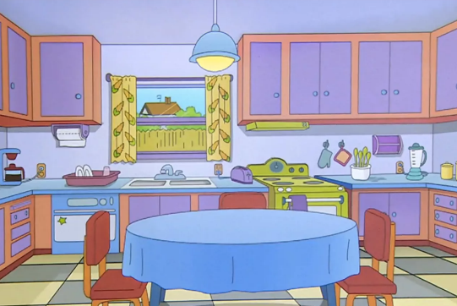
Experimental!
Your task for the rest of the lesson is to experiment with Photoshop to create a Simpsons scene with different characters (each character should have its own layer).
You should try to use different layers, text and tools to create your scene.
You have a few options of backgrounds:

Slide 64

Checkpoint!
So far, we have been able to:
  Insert an image, placing them into layers
  Resize layers
  Clone parts of an image
  Remove background from an image
  Add text onto a graphic
  Add blending options
  Fill in areas of an image with colour
  Save Photoshop files
  Export Photoshop files as a png image

Slide 65



The Next Steps…
We will now be looking to make a 2D image look 3D.
Open Activity 3 in Photoshop.
Using the Paint Bucket Tool, you need to colour in your dragon first of all.
Remove the Background from your image.
When Done, turn off your monitor.

Slide 66
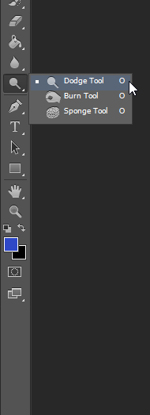
The tools we are now going to use are the Burn and Dodge tools.
Q. Can anyone remember what these do?

Slide 67
Burn Tool
Dodge Tool
Uses a brush to darken parts of an image
Uses a brush to lighten parts of an image
Amazing Hint!
Use [ and ] on your keyboard to change the brush size!

Slide 68
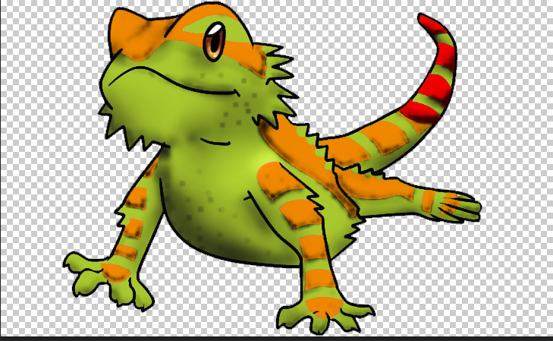
You have 5 minutes now to use the Burn Tool to add shadowing.

Slide 69
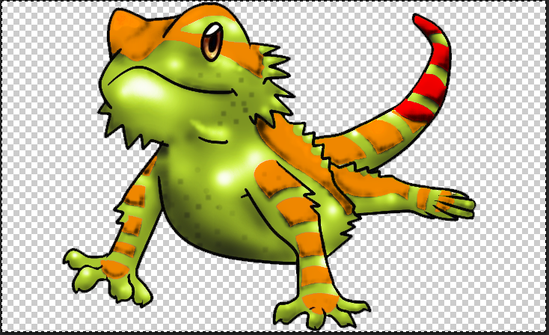
You have 5 minutes not to use the Dodge Tool to add shine + highlights.

Slide 70
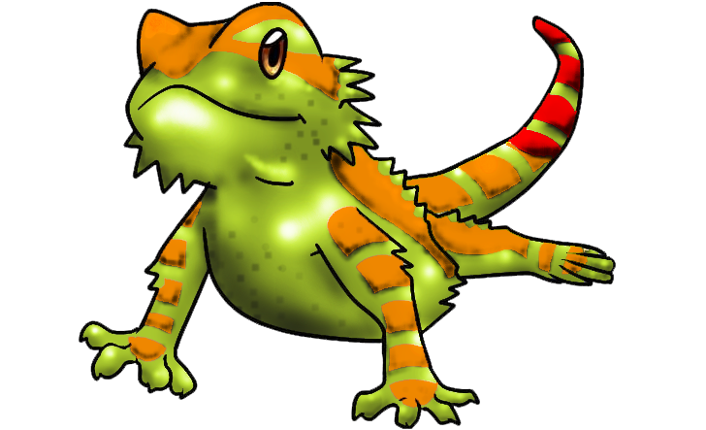
Export your Photoshop file as a PNG Image.

Slide 71
Layering Images
We are now going to be working with layers in Photoshop.
This is a bit like sticking things down onto a piece of paper – we can create some pretty cool and unique graphics by using layers!
Our next exercise is to add layers to images.

Slide 72
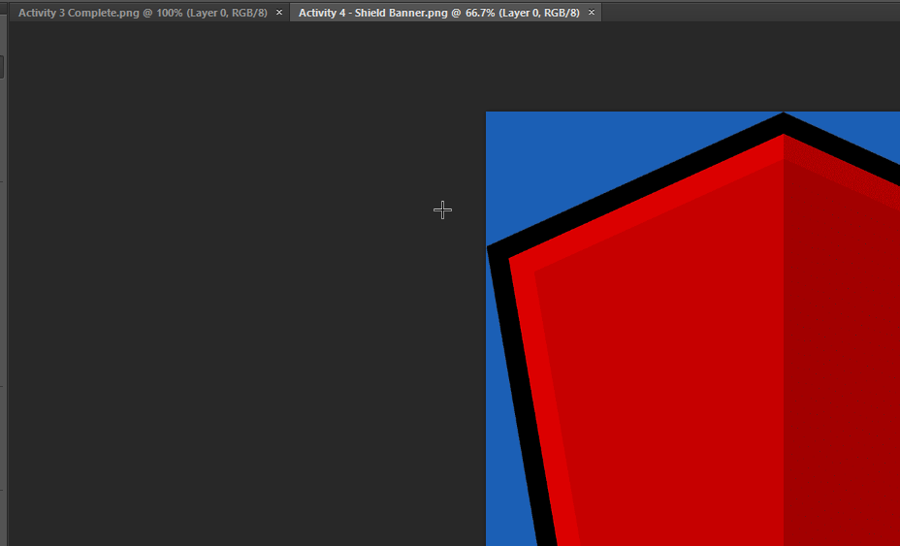
Adobe Photoshop
STEP:
13
Tool/Skill Used:
Photoshop Layers
Purpose:
Allows us to layer our images on top of each other
Save ‘Activity 4 – Shield Banner’ into your area under your Photoshop folder.
Open this in Photoshop
Also Open the image of your Lizard/dragon from earlier.

Slide 73
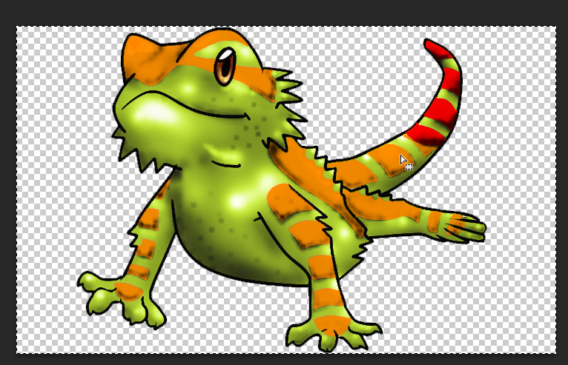
Adobe Photoshop
STEP:
14
Tool/Skill Used:
Copy and Pasting!
Purpose:
Place two files into one image
Click on your Activity 3 image.
Press Ctrl + A to select all. You will get a matching border around the whole image.
Press Ctrl + C to Copy this selection.

Slide 74

Adobe Photoshop
STEP:
15
Tool/Skill Used:
Pasting!
Purpose:
Place two files into one image
Click on your Activity 4 tab.
Press Ctrl + P to paste your image into a new layer above your shield banner.

Slide 75
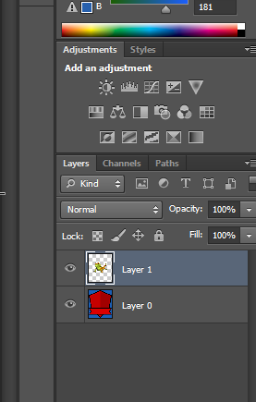
Adobe Photoshop
STEP:
15
Tool/Skill Used:
Layers
Purpose:
Selecting Layers
The Lizard is on its own layer (Layer 1) with the Shield in Layer 0.
We can move these layers independently from each other. So make sure you have clicked on Layer 1.

Slide 76

Adobe Photoshop
STEP:
15
Tool/Skill Used:
Layers
Purpose:
Moving Layers
Using the Move Tool (V) in the toolbox, you can move the lizard further up the screen so it isn’t covering the bottom part of the banner.
Now add a text layer and put your name in the banner at the bottom. Position this also.

Slide 77
EXPERIMENT!
You have this lesson to change colours of the shield – make it your own! Add your own background instead of the blue (Note. You should do this by adding a new layer!).

Slide 78
Save your work as ‘Activity 4 – My Crest’
We will be peer assessing this work before we continue to the assessed task.
This will be in the form of ‘Two Stars and a Wish’
  Two good things you really liked about your peers work
  One improvement they could make to improve next time
When you have finished, you will review your work by stating one target you have before starting the next piece of work. Take note of this in a Microsoft Word document called ‘Graphic Improvements’.

Slide 79
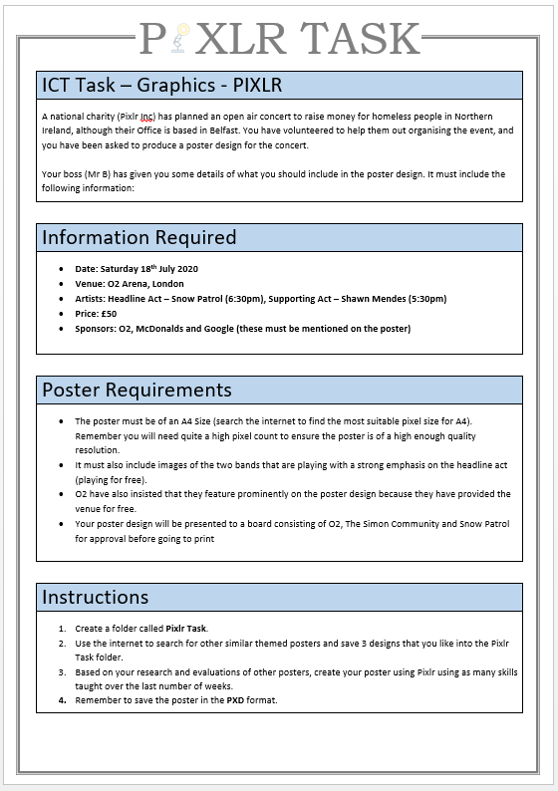
Assessed Task: Pixlr Inc.
You have a total of three lessons to complete the ‘ASSESSMENT - ICT PIXLR TASK’ assessment.
You will be marked on:
  Research and its inspiration for your own poster
  Creativity
  Planning and Organisation (including Files and Folders)
  Use of Layers + other tools
  Colour Scheme (3-5 Colours)
  Including key information
  Presentation and use of logos/brand names

